Slide 1
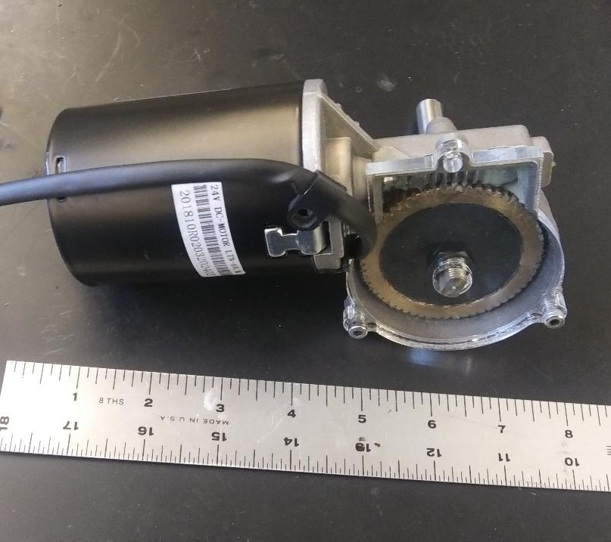
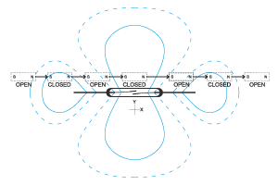
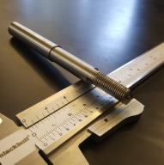
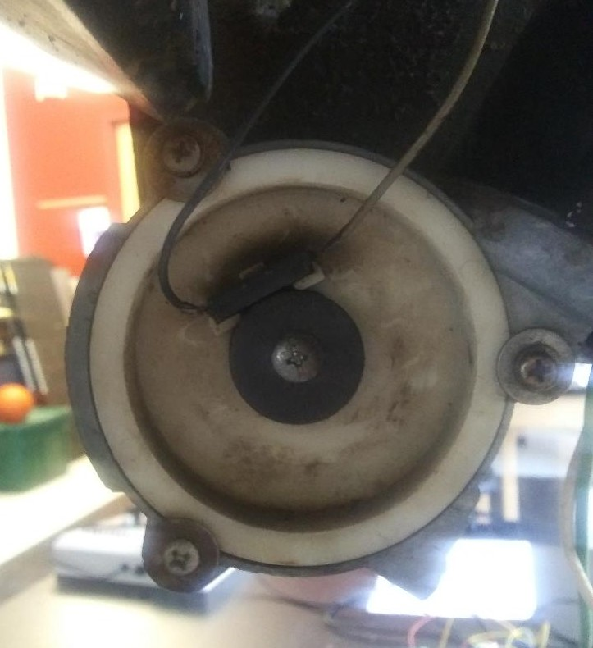
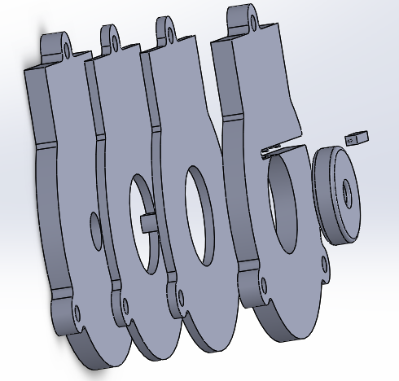
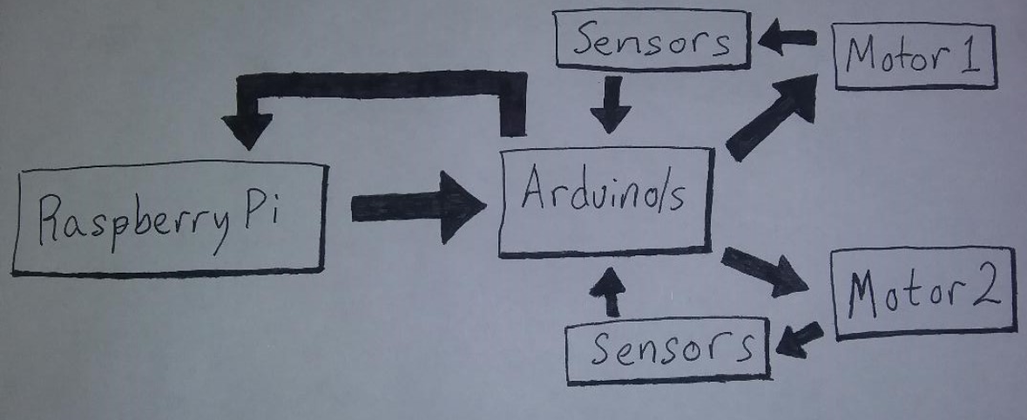
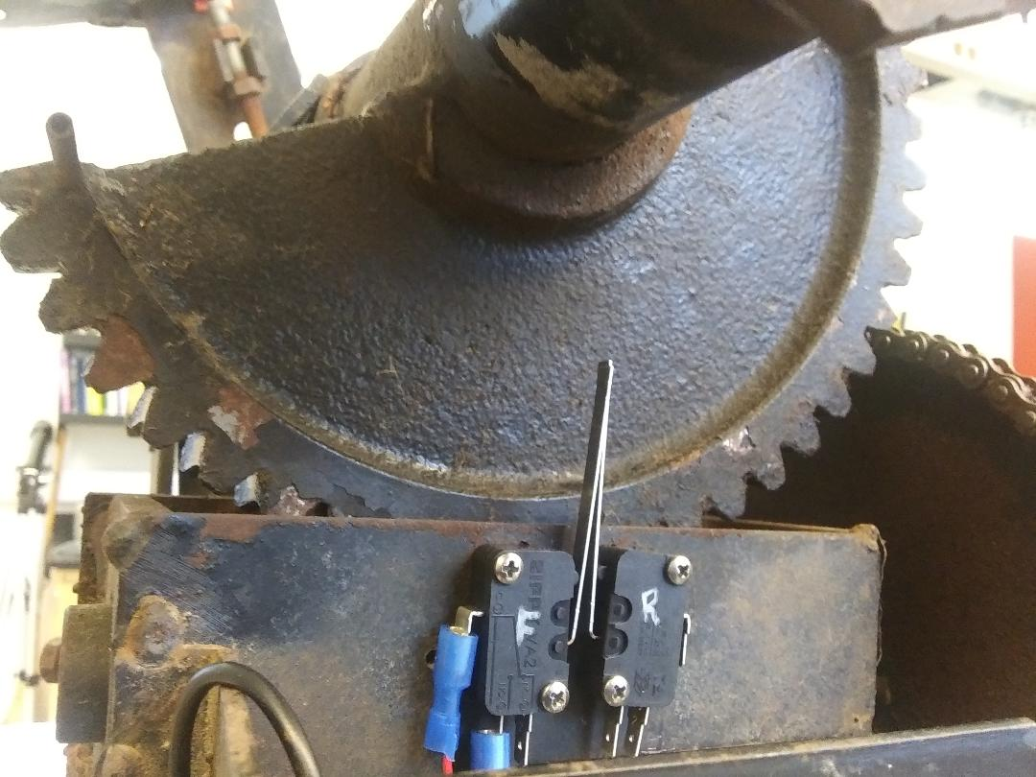
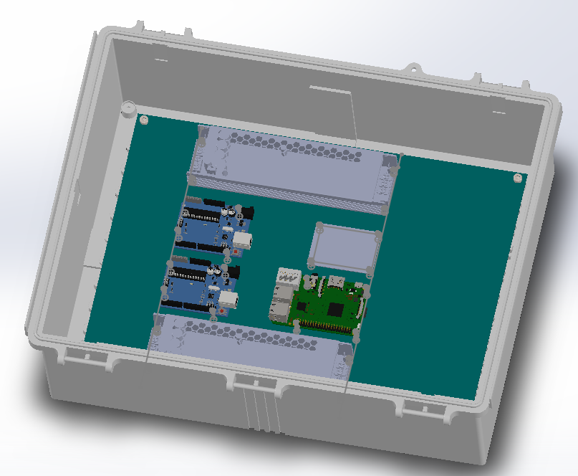
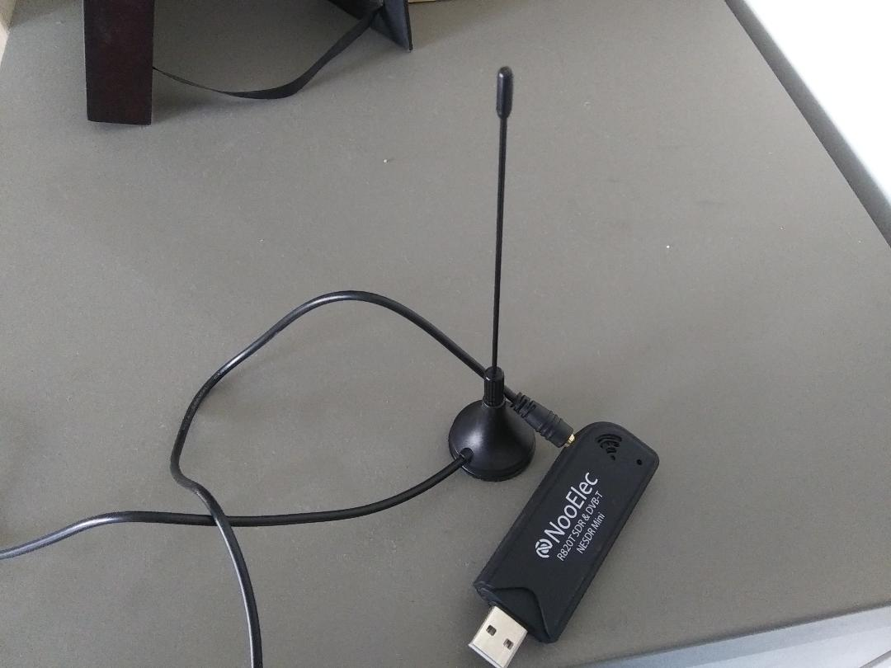





A Small Radio Telescope (SRT), originally developed by MIT’s Haystack Observatory, was donated to Winona State University by Mayo High School in Rochester, Minnesota. The assembly includes a 2.3 meter dish with mount and motors that allow pointing over the entire sky. The SRT, unfortunately, has been weathered over years of exposure to the elements, and was absent all the electronics necessary for pointing and collecting data. Here we report our efforts to repair, replace, and refurbish the SRT for future undergraduate research. Specifically, the replacement of pointing hardware, the development of a motor control system and graphical user interface (GUI), and future work to implement a software defined radio (SDR) for detection of astronomical signals.
Abstract
Figure 1: A full assembled SRT with a similar design to our own.
Figure 2: Two motors are used to point the dish in the appropriate location in the sky. One of our existing motors was no longer working so replacements were obtained.
Figure 6: Hall effect sensors, or “reed switch”, are switches that close a circuit in the presence of an appropriately strong magnetic field. By including a reed switch in a circuit on the digital input port of a microcontroller, the proximity of a magnet can be detected.
Figure 3: The gear shafts that came with the motors did not conform to the design of the larger mounting system. New gear shafts needed to be cut on a lathe to meet the specifications of the system.
Hall Effect Sensor
Figure 7: The reed switch will be monitored by an Arduino microcontroller which will count the number of turns the motor has undergone. This will allow a precise measurement of the direction of the SRT dish to about 0.1° on the sky.
Motors
Figure 4:
The replacement motors had metal covers that interfered with our reed switch (Hall Effect) sensors, so new covers have been produced. Covers are first modeled in Solidworks, then laser printed on a Glowforge.
Figure 7: An Arduino microcontroller will communicate to a Pololu Motor Driver Carrier to send current in the appropriate direction to the motors. The Arduino will also handle all the sensor communication while a Raspberry Pi takes care of the higher level programming needs.
Replace this
Figure 5: Two switches will limit the turning of the final conversion gear for each respective mount, preventing motion beyond the recommended range. Additionally, the sensors will assist in calibrating by acting as a check for the gear’s definite position.
Figure 8: A water proof plastic box will house the electrical components required for the SRT’s movements. The assembly will first be mapped in SolidWorks to ensure the ideal layout is achieved, prior to the purchase of components.
Figure 9: Running on the Raspberry Pi; a DashDAQ GUI has been created to allow for a user friendly interface to control the SRT operations. Taking inputs of Right Ascension and Declination the user can choose between several observation functions and see the trajectory of their object mapped on the local sky.
Further finalization and completion of the work presented here
Implementation of an SDR for data taking
Software to analyze information received by the SDR
Astronomical observations to be made with this telescope
Future Work
Figure 10: Example of and SDR that might be used on the SRT.

